Slide 2
Introduction to Business Problem
The Fashion Store conducted marketing initiatives from July through November, designed to boost clicks, conversions, and customer interaction. These efforts employed diverse ad formats and promotional tactics, capitalizing on seasonal trends to enhance performance and achieve higher revenue
Campaign Performance Evaluation:
Seasonal trend analysis
Performance metrics: Clicks, Impressions, Cost, P&L
Optimization Strategies for Ads Spending & Promotions:
Optimizing advertising spend
Enhancing promotional strategies

Slide 3
Analysis Framework
Comprehensive Overview of Advertising Performance
Evaluating the Impact of Promotional Strategies
Key Takeout & Recommendation

Slide 4
Comprehensive Overview of Advertising Performance

Slide 5

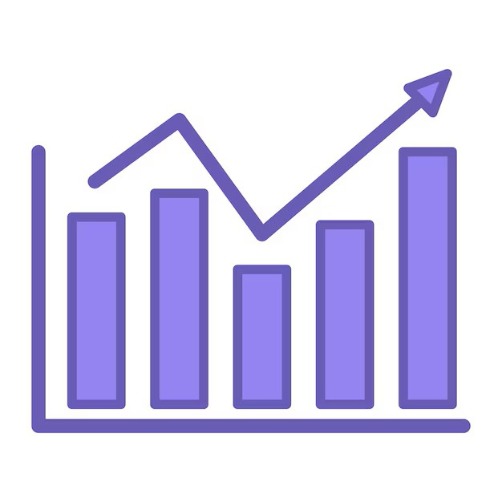
Despite a decrease in ad volume, clicks and impressions surged dramatically in November
Ad counts peaked at 49 in August and September before declining to 42 by November
Clicks and impressions declined from July to October, indicating stagnation in engagement. However, November saw a dramatic surge in impressions (+258%) and clicks (+226%), despite a decline in ad volume, suggesting increased budget allocation or improved campaign visibility
+237%

Slide 6
251.5%
Increased ad spend did not translate to profitability, highlighting inefficiencies in budget allocation.
October’s controlled spending (87k) led to profitability (+909K), while November’s budget surge (307K) lacked efficiency, resulting in a significant loss (-32.8K). Stable spending from July to October (87K–307K) highlighted past inefficiencies, proving that higher investment alone (+251% in November) doesn’t guarantee better outcomes.

Slide 7
Evaluating the Impact of Promotional Strategies

Slide 8
The overall ad volume remained relatively stable from July to November, fluctuating slightly between 42 and 49 units. In November, despite the introduction of Black Friday campaigns, total volume dropped marginally ,suggesting a reallocation of resources rather than an expansion in ad activity.
Promotional strategies stayed consistent, with Promotion Codes and Discount Codes dominating spending
Promotion Codes and Discount Codes remained the dominant promotion types, accounting for 48% of total promotions, reinforcing their priority in campaign execution and reliance on direct incentives.

Slide 9
Promotion Codes and Discount Codes dominated ad spend, contributing 62% and 26%, respectively, highlighting a strong reliance on direct incentives. November saw a sharp increase in spending on these promotions, while Black Friday promotions remained minimal, indicating a low emphasis on seasonal events. Meanwhile, other promotions (Competitor, Free Shipping, and Sale) maintained consistently low spending, reinforcing a focused strategy on discount-based incentives.
Promotion & Discount code dominate Ad spent while others remain minimal
Monthly Ad spent breakdown by promotion type
Column1 | July | August | September | October | November
Promotion Code | 77048 | 71381 | 48834 | 54554 | 188727
Discount Code | 26690 | 21917 | 27266 | 21816 | 83488
Coupon Code | 14371 | 9082 | 6620 | 7508 | 18761
Sale | 3072 | 2271 | 2056 | 1574 | 7172
Offer | 752 | 777 | 1968 | 1539 | 7869
Competitor | 470 | 466 | 300 | 273 | 762
Free Shipping | 205 | 164 | 104 | 88 | 261
Black Friday/Cyber Monday |  |  |  |  | 47

Slide 10
Likely reaching target audience
Most promotion types had negative P&L, highlighting inefficiencies in ad spend
Most promotion types had negative P&L, exposing ad spend inefficiencies. October saw profitable returns from Discount Code, Promotion Code, and Coupon Code, proving controlled spending works. November’s high investment failed to generate profits, reinforcing that higher spend ≠ better performance. Black Friday promotions had minimal impact, while other promotion types showed little profitability influence
Row Labels | July | August | September | October | November
Discount Code | -6807.162 | -3276.849 | -4620.817 | 964.008 | -8174.446
Coupon Code | -3302.77 | -1243.464 | -862.235 | 585.493 | -1639.745
Promotion Code | -10964.262 | -9400.374 | -8004.41 | 438.151 | -15150.56
Competitor | -76.499 | -7.203 | -121.644 | -33.946 | -229.974
Free Shipping | -11.362 | -64.828 | 2.105 | -37.993 | -65.785
Offer | -116.68 | -177.235 | -688.181 | -184.568 | -2272.962
Sale | -1591.122 | -894.025 | -913.292 | -821.933 | -5471.104
Black Friday/Cyber Monday |  |  |  |  | 157.909
+1.987,6
+157.9
Low cost, still positive P&L

Slide 11
High ad spend, CTR, and CR failed to drive profitability, exposing inefficiencies in budget and targeting.
CTR had correlated unclearly with CR, High CTRs didn't reliably deliver conversions
The unchanged CR across spend fluctuations suggests poor audience targeting.
Profits rose only after October's ad spend optimization, highlighting the value of strategic budget allocation.

Slide 12
Key Takeout & Recommendation

Slide 13
Key Takeouts
Optimized Spending Drives Profitability Efficient budget control in October drove a positive P&L, emphasizing that strategic spending outweighs high spending.
Higher Ad Spend ≠ Higher Profitability November’s budget surge failed to improve returns, proving that strategic spending is more impactful than increased investment
Maketing Campaign
Discount-Based Promotions Were Overused Promotion & Discount Codes dominated spending (88%), indicating heavy reliance on direct incentives while seasonal campaigns remained underutilised.
Targeting & Content Optimization Matter CTR and CR did not directly correlate, highlighting the need for better audience segmentation and content refinement.

Slide 14
Marketing Strategy
Seasonal Marketing Plan Development
Building a Performance Monitoring Dashboard
Seasonal Campaign Alignment – Leverage key shopping events to boost sales and engagement.
Product-Focused Strategies – Tailor promotions with targeted discounts and bundling offers.
Multi-Channel Marketing – Maximize reach via digital ads, social media, email, and influencers.
Customer Retention & Loyalty – Enhance engagement with personalized offers and membership
Building a Performance Monitoring Dashboard
Real-Time Campaign Monitoring – Track ad performance across channels and detect inefficiencies early.
KPI-Based Performance Evaluation – Measure key metrics (CTR, CPC, CPA, ROAS) and compare against targets.
Budget & Resource Optimization – Allocate spending effectively by identifying high-performing channels.
Faster & Smarter Decisions – Use visualized data for quick insights without manual report checking.

Slide 15
Seasonal Marketing Plan Development
Clearance & Early-Year Sales
Mid-Season Growth & Summer Collection
Inventory Clearance & Fall Collection Launch
Peak Sales & Holiday Shopping
Objective:Boost early-year sales, clear winter inventory, and leverage holiday shopping. Key Campaigns:
Sale 1.1 & Winter Clearance Sale – Flash sales on winter stock.
Lunar New Year Sale – Festive promotions to maximize holiday revenue.
Valentine’s Day & Women’s Day (8.3) – Targeted promotions for gifting season.
Spring Collection Launch (Sale 3.3) – “Buy More, Save More” campaign.
Objectives: Maintain sales momentum, launch summer collections, and drive engagement. Key Campaigns:
Sale 4.4 & 5.5 – Trend-based flash sales and early access deals.
Mother’s Day & Father’s Day – Special discounts on gifting products.
Summer Essentials (Sale 6.6) – Loyalty member discounts.
Spring-Summer Clearance – Mid-year discounts before new arrivals.
Objectives: Optimize inventory, introduce fall styles, and capture seasonal shopping demand. Key Campaigns:
Independence Day (4.7 – Global) – Discounts on patriotic-themed products.
Sale 7.7 & 8.8 – Bulk discounts for mid-year clearance.
Back to School – Student ID discounts.
Mid-Autumn Festival Sale – Traditional outfit promotions.
Fall Collection Launch (Sale 9.9) – “Buy 2, Get 1 Free” offers.
Objectives: Maximize revenue during peak season, leverage holiday gift shopping, and clear year-end inventory. Key Campaigns:
Halloween & Sale 10.10 – Themed discounts on party wear.
Black Friday & Cyber Monday – Up to 50% off flash sales.
Singles’ Day (11.11) & 12.12 – High-volume promotions.
Year-End Clearance & New Year’s Eve Sale – VIP markdowns and festive outfit discounts.

Slide 16
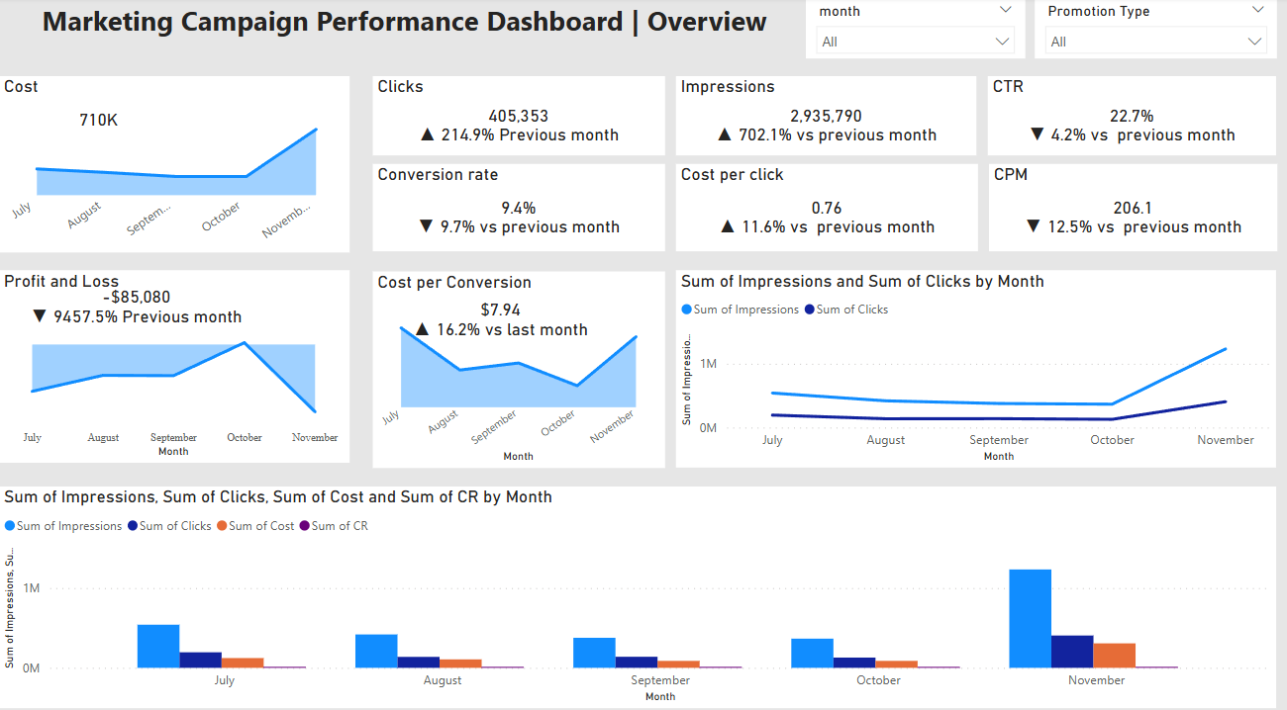
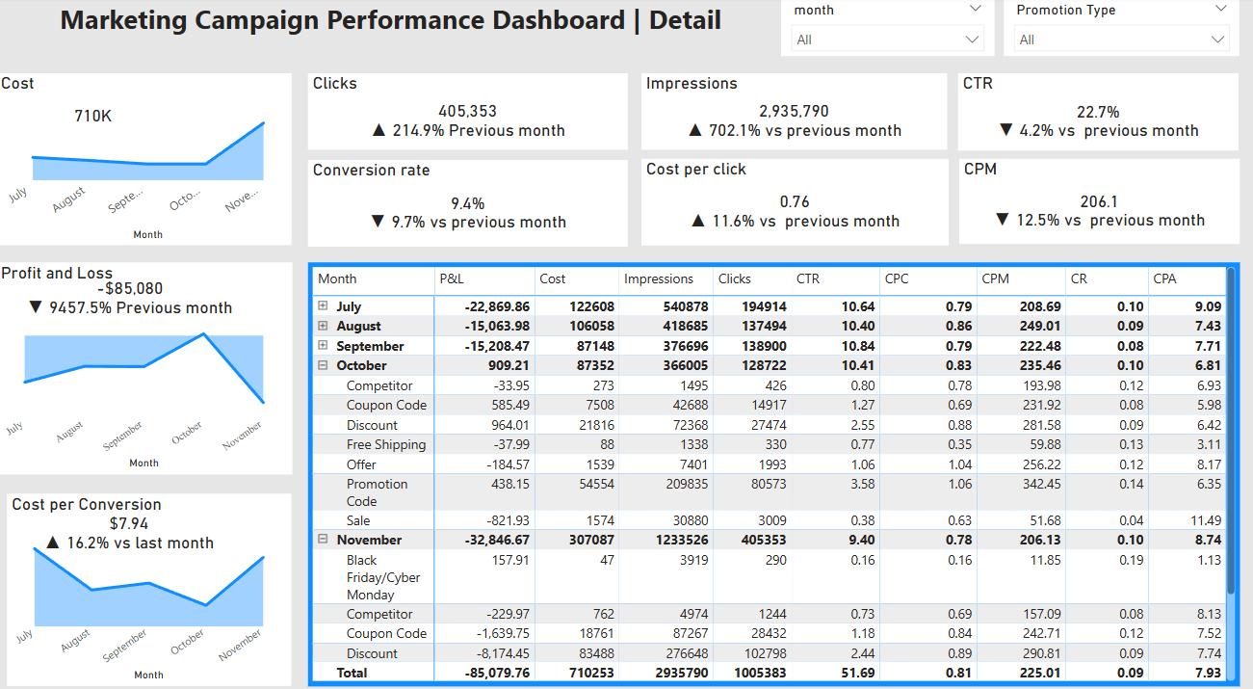
Building a Performance Monitoring Dashboard
Real-Time Monitoring
Track key ad metrics to optimize spending.
Performance Evaluation
Measure reach, engagement, and conversion effectiveness.
Budget Optimization
Identify high-performing campaigns for better allocation.
Profitability Analysis
Assess ROI and eliminate underperforming ads.
Data-Driven Decisions
Enable quick adjustments for improved ad efficiency.

